Slide 1

Managing and deploying R packages across an organisation – Cat-herding 101
Mike K Smith
(Pfizer UK Ltd.)

Slide 2
Or… How to get oldR with style

Slide 3
How many of you have R-3.5.1 installed?

Slide 4
How many kept their previous installation (separate)?

Slide 5
How many kept their libraries of packages for each version separate?

Slide 6

Your R installation process (may) be like

Slide 7
If you had to re-run an analysis you did >10 years ago (using R), could you?

Slide 8

Our R on HPC GRID

Slide 9
We have R-1.9.1 available on the HPC GRID (2004)

Slide 10

R on colleagues desktops

Slide 11
Desktop R
We qualify and release versions of R for desktop, with a “snapshot” set of packages.
God alone knows whether colleagues get their R from this version (or CRAN).
And who knows what packages they have, what versions or where they got them.

Slide 12
Desktop R
We qualify and release versions of R for desktop, with a “snapshot” set of packages.
God alone knows whether colleagues get their R from this version (or CRAN).
And who knows what packages they have, what versions or where they got them.

Slide 13
Desktop R
We qualify and release versions of R for desktop, with a “snapshot” set of packages.
God alone knows whether colleagues get their R from this version (or CRAN).
And who knows what packages they have, what versions or where they got them.

Slide 14
My job

Slide 15
How do I (try to) help?
Set up and maintain miniCRAN “snapshot” of packages for a given release.
Including CRAN, Github and internal packages
Following installation of (base) R, colleagues use installation script to install ALL packages.
That way, they don’t have to run install.packages( ), just call library(…)
Provide functions that allow colleagues to check, update, add, install packages to reconcile what they have compared to our miniCRAN list.
Ensure that desktop and HPC GRID package list matches.
Develop code on desktop, run for reproducibility on GRID.

Slide 16
How do I (try to) help?
Set up and maintain miniCRAN “snapshot” of packages for a given release.
Including CRAN, Github and internal packages
Following installation of (base) R, colleagues use installation script to install ALL packages.
That way, they don’t have to run install.packages( ), just call library(…)
Provide functions that allow colleagues to check, update, add, install packages to reconcile what they have compared to our miniCRAN list.
Ensure that desktop and HPC GRID package list matches.
Develop code on desktop, run for reproducibility on GRID.

Slide 17
How do I (try to) help?
Set up and maintain miniCRAN “snapshot” of packages for a given release.
Including CRAN, Github and internal packages
Following installation of (base) R, colleagues use installation script to install ALL packages.
That way, they don’t have to run install.packages( ), just call library(…)
Provide functions that allow colleagues to check, update, add, install packages to reconcile what they have compared to our miniCRAN list.
Ensure that desktop and HPC GRID package list matches.
Develop code on desktop, run for reproducibility on GRID.

Slide 18
How do I (try to) help?
Set up and maintain miniCRAN “snapshot” of packages for a given release.
Including CRAN, Github and internal packages
Following installation of (base) R, colleagues use installation script to install ALL packages.
That way, they don’t have to run install.packages( ), just call library(…)
Provide functions that allow colleagues to check, update, add, install packages to reconcile what they have compared to our miniCRAN list.
Ensure that desktop and HPC GRID package list matches.
Develop code on desktop, run for reproducibility on GRID.

Slide 19


Colleagues range in attitudes…
“I don’t care, just give me the packages I need to get my work done…”
“Get out my way, I know
what I’m doing…”

Slide 20
Yes, I know other options are available
Microsoft R Open (MRO) + MRAN + checkpoint( )
I LIKE the concept.
BUT Github, internal packages?
packrat
Yes, BUT… consistency in packages ACROSS analyses AS WELL AS reproducibility.
Desktop vs HPC GRID
RStudio Package Manager
Somewhere between packrat and miniCRAN and MRAN?

Slide 21
But ultimately…
No matter what we do, we need to:
be able to move quickly without breaking things
push packages out in a controlled manner
square up desktop and HPC GRID packages
be able to support ALL colleagues
Research – latest, greatest, NOW.
Regulatory work – controlled, qualified.
facilitate reproducibility
Potentially for YEARS…

Slide 22
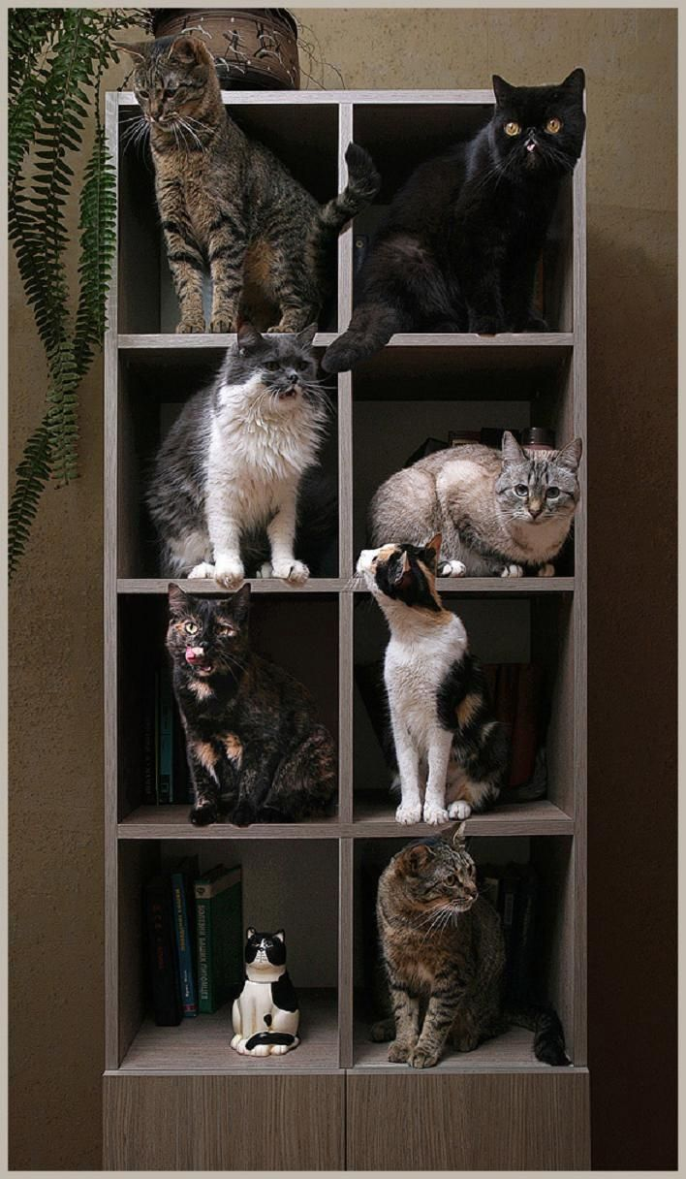
Cats herded

